Slide 1
Kinect + TFS aka Kinban
Jeremy Novak
Farm Credit Services of America

Slide 2
Agenda
Why we built it
The Glue
Kinect & SDK
TFS API
Lessons Learned
Resources

Slide 3
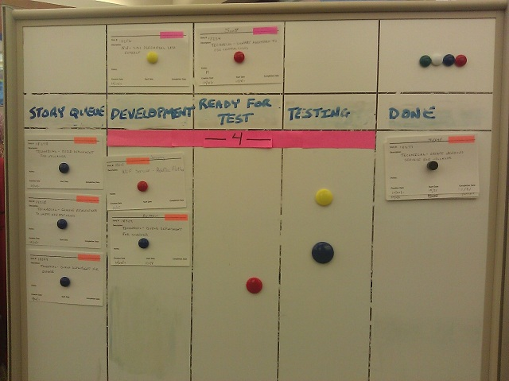
Why
FCSA leaders sponsored Geekfest – Sept 2011
Replace index card based Kanban story board
Because Kinect is
Different
Cheap
Notes:
Geekfest: a 48 hour (2 days) time period given to the App Dev teams to develop anything we want.

Slide 4
The Glue
AutoIt
COM Component
Mouse control
Move to X, Y
Press/Release button
FCSA QA uses AutoIt for UI automation testing
Win32 mouse functions might work?

Slide 5
More Glue
WPF UI
Great for styling
Great for user interactivity
Drag Drop Adorner
Shows user story dragging
Dims user story for invalid drop column
How the UI works DEMO

Slide 6
Reactive Extensions aka Rx
System.Reactive namespace
Async Observer Pattern with Linq operators
Rx is used to wrap Kinect Events

Slide 7
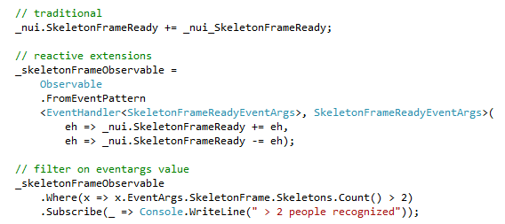
Contrived Rx Example

Slide 8
Kinect & SDK
$150 hardware and free software for
Camera, Depth sensor, Microphone array, Skeleton tracking
SDK Data streams – delivered at 30 FPS
Skeleton
Depth
Video

Slide 9
SDK Cont’d
Includes sample apps
Skeleton Tracker
A Simple Skeleton based game
Speech recognition
New version as of Nov 1
App built with previous beta

Slide 10
Kinban Gestures
Kinban uses Simple Gestures
Right hand moves mouse
Movement constrained to a Virtual Box
Translates meter measurements to screen resolution
Left hand controls mouse button
Move left wrist above left elbow for mouse down
Interacting with Kinban DEMO

Slide 11
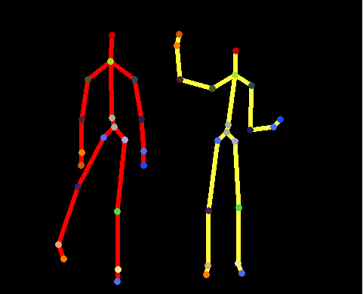
Skeleton
Data points for all Joints
Values are meters
X Left/Right
Range of -1 to 1
Y Up/Down
Range of -1 to 1
Z Closer/Farther
Range of ~0 to ??
X = 0, Y = 0 is center of Kinect sensor

Slide 12
More on Reactive Extensions
Kinban chains together Rx based streams for:
Gestures
Easily scaling frame rate
Convert Kinect data to WPF friendly images

Slide 13
Rx Skeleton Data Flow
Skeleton Frame
Closest Skeleton Filter
Sample Rate Filter
FPS Counter
Standing too close
Mouse Down
Gesture
Mouse Position
Gesture
AutoIt
Diagnostic UI

Slide 14
TFS API
Kinban’s needs are simple
Assignment of employee
User story status change
High level TFS API inputs are
Project Collection URI
Ex: http://server:8080/tfs/AppCollection
Project Name
Uses WIQL (Work item query language)
DEMO

Slide 15
Lessons Learned
Mouse Control
Absolute mode
Joystick mode
Drag and Drop adorner code was finicky
Screen Resolution
Size of screen elements
Granularity of mouse control

Slide 16
Lessons Learned Continued
Mouse button down. Tried:
Distance from right hand to Kinect
Left arm up
Loitering in front of the Kinect
Still need a better way to screen lock
Logged in user needs access to TFS

Slide 17
Resources
This Project
http://kinban.codeplex.com
AutoIt
http://www.autoitscript.com/site/autoit/downloads/
Kinect SDK
http://kinectforwindows.org/download/
Example of Advanced gestures
http://kinecttoolbox.codeplex.com/

